Slide 1

DC-DC Converter for PV Module Integration
Group 760

Slide 2

CONTENT
INTRODUCTION
CONVERTER DESIGN
MPPT ALGORITHM
TESTS RESULTS
DISCUSSION
CONCLUSION

Slide 3
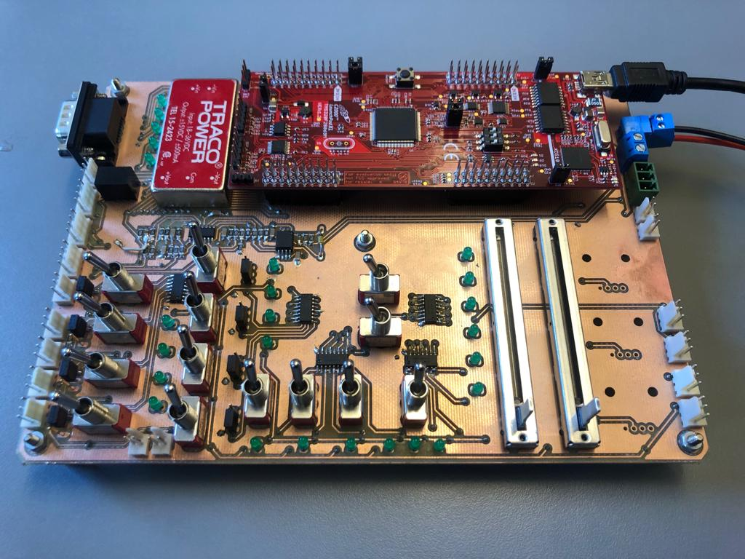
Hardware
Notes:
Motivation
Existing problems
What is a MIC
Why a MIC
Problem statement

Slide 4
Interface Board
Slide
of 59
Sections of board
Power supply
DSP development kit
Reference selection
Faheem

Slide 5
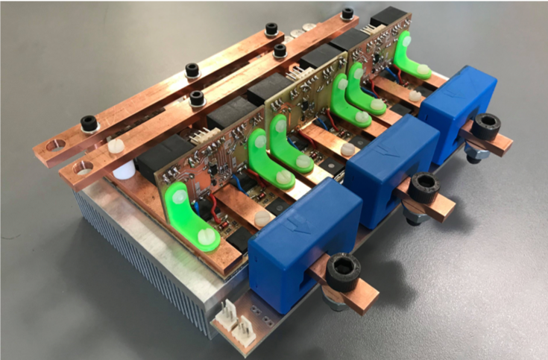
Inverter
Slide
of 59
Inverter Electrical Characteristics
Power capability : 7.3kW
DC link voltage : 36V
Switching frequency : 20kHz
MOSFET Used
Infineon OptiMOSTM : 80V 300A
Package type : PG-HSOF-8-1
Max. allowed T_{j} : 175℃
Faheem

Slide 6
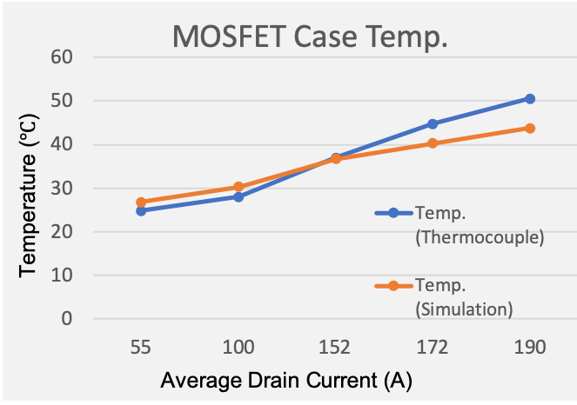
Inverter thermal test
Slide
of 59
Inverter case temperature test at different operating condition up to rated values
DC link voltage (V) | Average drain current (A) | Temp. (Thermocouple) (℃) | Temp. (Simulation) (℃)
12.5 | 55 | 24.8 | 26.8
18 | 100 | 28 | 30.3
24 | 152 | 37 | 36.7
33 | 172 | 44.8 | 40.3
38 | 190 | 50.5 | 43.8
Faheem

Slide 7
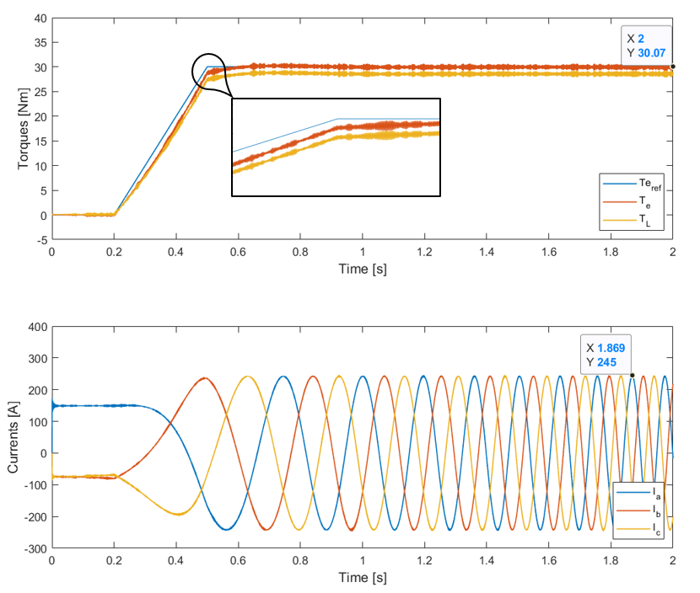
Simulation result
Slide
of 59
Torque Control

Slide 8
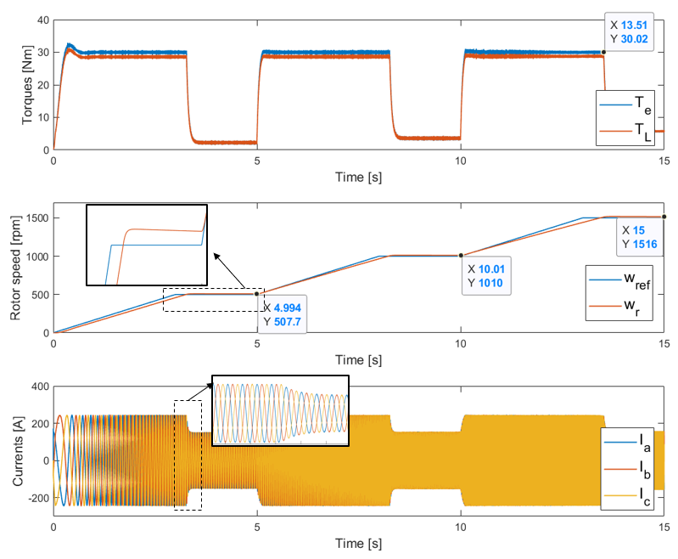
Simulation result
Slide
of 59
Speed Control

Slide 9
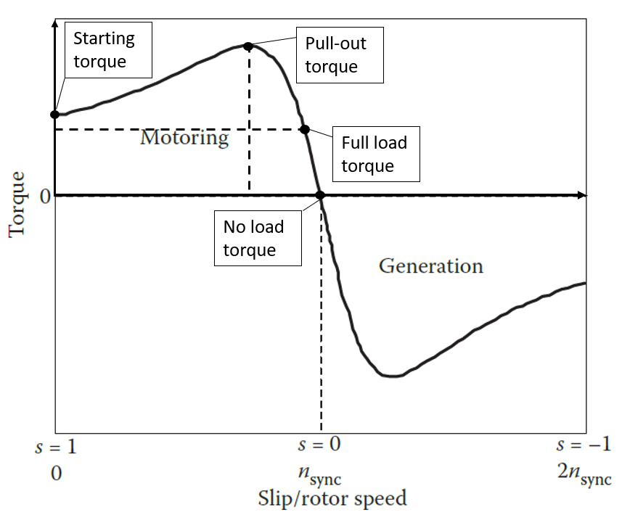


Regenerative braking
Slide
of 59
When the rotor speed is higher than synchronous speed (i.e., negative slip), the machine runs in generation mode
$slip= \frac{n_{sync} − n_{rotor}}{n_{sync}}$
$$n_{rotor}> n_{sync}$$
Negative slip
Negative torque
Faheem

Slide 10
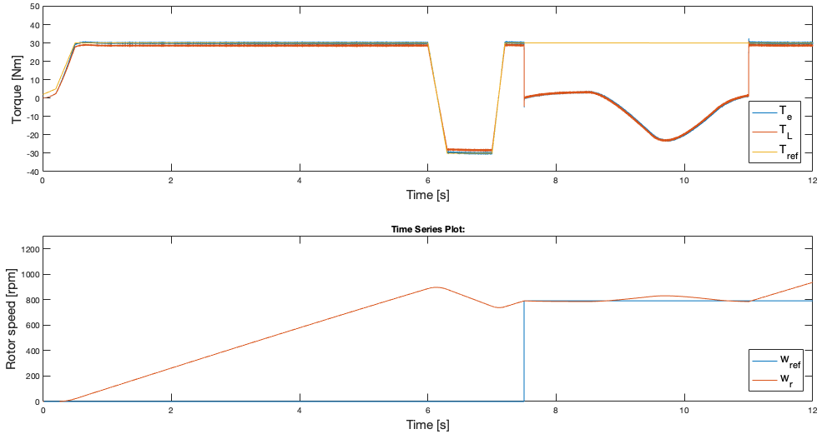
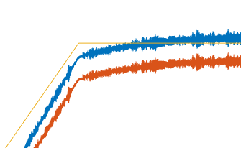
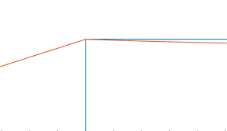
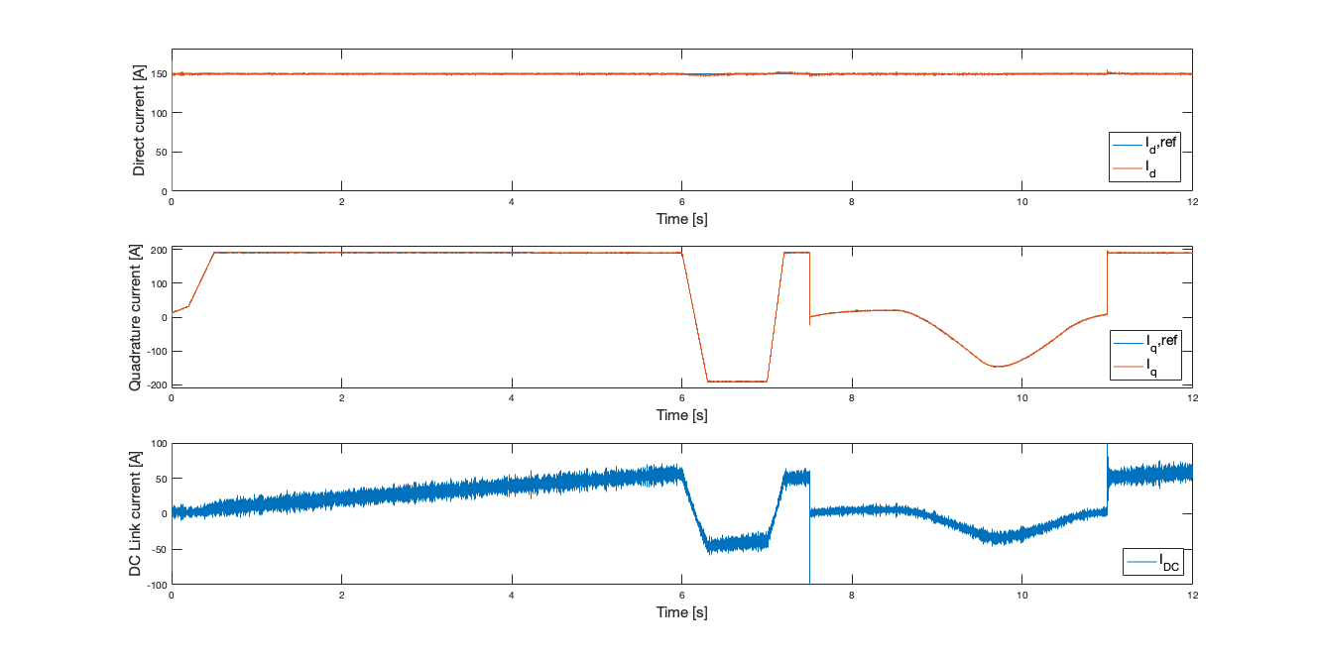
Regenerative braking simulation
Motor stops following torque reference during speed control
Slide
of 59
Downhill slope of 10°
Speed Control Region
Torque Control Region
Both in torque control & speed control
Negative DC link Current

